Slide 1
A New Spin on an Old Classic: Effective Online Database Instruction
Leslie Sult, University of Arizona
Yvonne Mery, University of Arizona
Erica DeFrain, University of Vermont
41st Annual LOEX Conference
May 3, 2013
Nashville, TN

Slide 2
Why we did this:
Scale
Declining budgets
Need to reach distance students

Slide 3
The Guide on the Side

Slide 4
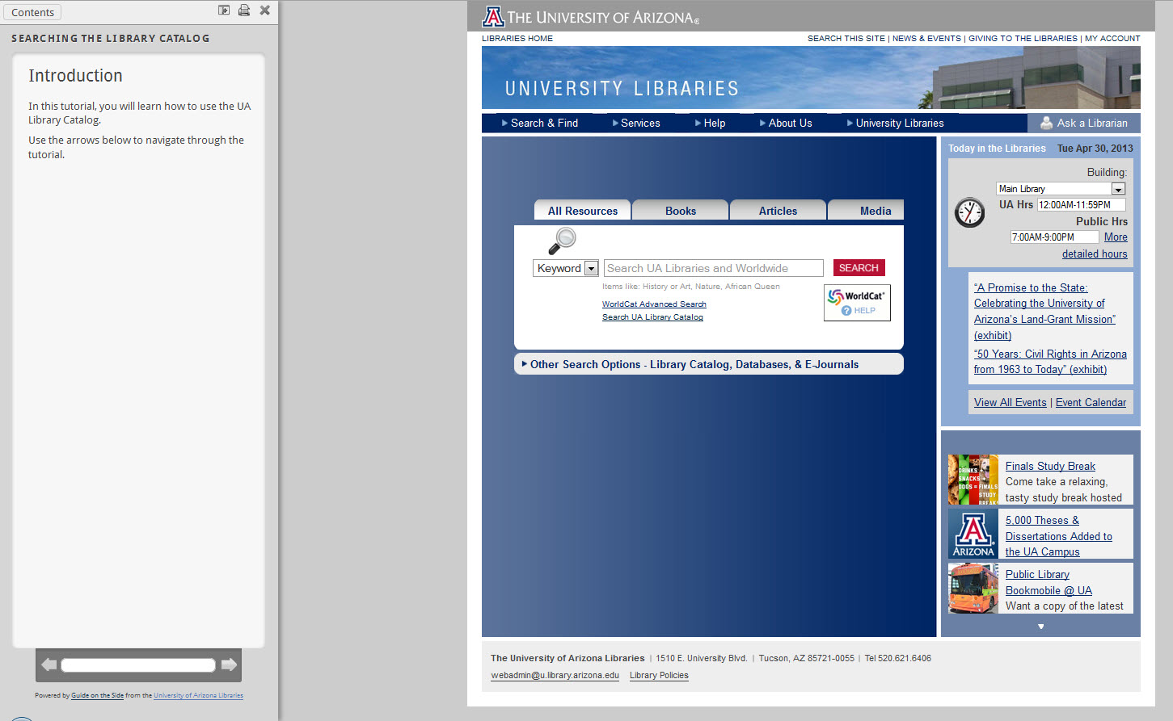
The Guide on the Side

Slide 5
How we did this:
Many iterations
Skilled programmers

Slide 6
The Interface

Slide 8
Best Practices: Text
On the average Web page, users have time to read at most 28% of the words during an average visit; 20% is more likely.

Slide 9
Best Practices Text:
Keep it to a minimum
Break text apart with spaces, bullets, chapter headings
Highlight words
Include steps

Slide 10
Best Practices: Questions
Individualize feedback
Ask a variety of questions: short answer, long answer, multiple choice, T/F
Comprehension checks: Knowledge and Evaluation
Navigational questions

Slide 11
Best Practices: Practice, Practice!
Effective e-learning engages learners with the instructional environment in ways that foster the selection, organization, integration, and retrieval of new knowledge.
- Clark & Mayer
1. Address specific skills gaps
2. Include explanatory corrective feedback
3. Be in distraction-free environment
4. Transfer from tutorial to real world (authentic tasks)

Slide 12
Best Practices: Navigation
Pick your starting point with your audience in mind
Give clear, clear directions

Slide 13
Best Practices: Update
Have a regular updating schedule
Student workers can go through tutorials to locate mistakes
Look for:
Changes in formats - PDFs to HTML full-text
New items being added
Interface design

Slide 14
Other Uses
Programming: Code Academy
Web site evaluations

Slide 15
Research
Fall 2012 Study "A New Tool for Online Database Instruction: Evaluating the Effectiveness of the Guide on the Side"
H1: Asynchronous online instruction is an effective means of teaching database searching skills
H2: Students who complete the GotS tutorial will perform better on the posttest compared to students who view the screencast tutorial

Slide 16
VS

Slide 17
Methodology
recruited 90 undergraduates
Student newspaper ad
In-house recruitment
$15 giftcard, snacks

Slide 18
Methodology
recruited 90 undergraduates
no prior IL instruction
3 groups: Control (n = 30), screencast (n = 30), GotS (n = 30)
treatment
16 item posttest

Slide 19
"Two [instructional methods] enter, one [instructional method] leaves!"

Slide 20
Results
ANOVA: F(2, 87) = 10.009, p < .001, n² = .187

Slide 21
Results
Both treatments effective
Statistical dead heat

Slide 22
Feedback

Slide 23
Feedback
“I assigned this tutorial for my students in ENGL 102, and I'm really glad that I did! I found it to be really helpful, easy to understand, and a good refresher for people like me who use JSTOR all the time. Thanks!”
Students tend to like this instructional approach as well, for example a student in a history class submitted this feedback on the same JSTOR tutorial “This tutorial is extremely helpful and clear. It's a convenient way to learn the process.”

Slide 24
GOTS Awards
OITP 21st Century Cutting Edge Technology Service
ACRL Instruction Section Innovation Award

Slide 25
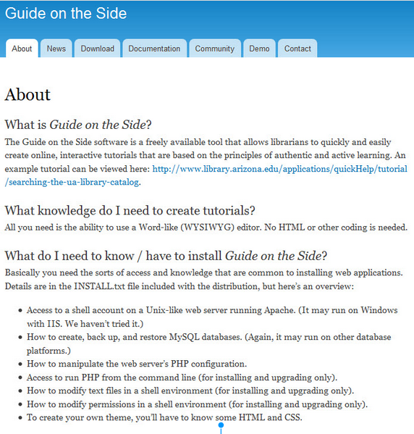
Download and Support
http://code.library.arizona.edu/gots/

Slide 26
Questions?

